Slide 1
Home Learning Pack
Key Stage 1
Key Stage 1 Art – Andy Goldsworthy
Lesson 3: Selecting materials to make spirals or circles.

Slide 2
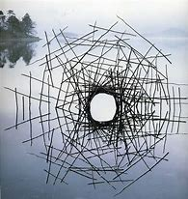
Today can you use materials to create spirals and circles?
What materials can you see?
What colours can you see?
What shapes can you see?

Slide 3
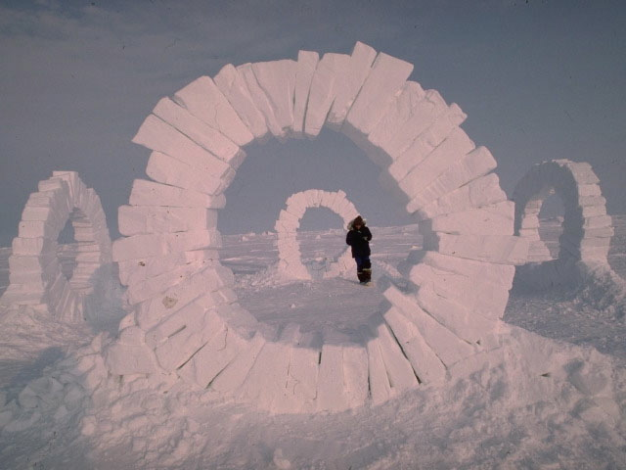
What materials can you see?
What colours can you see?
What shapes can you see?

Slide 4
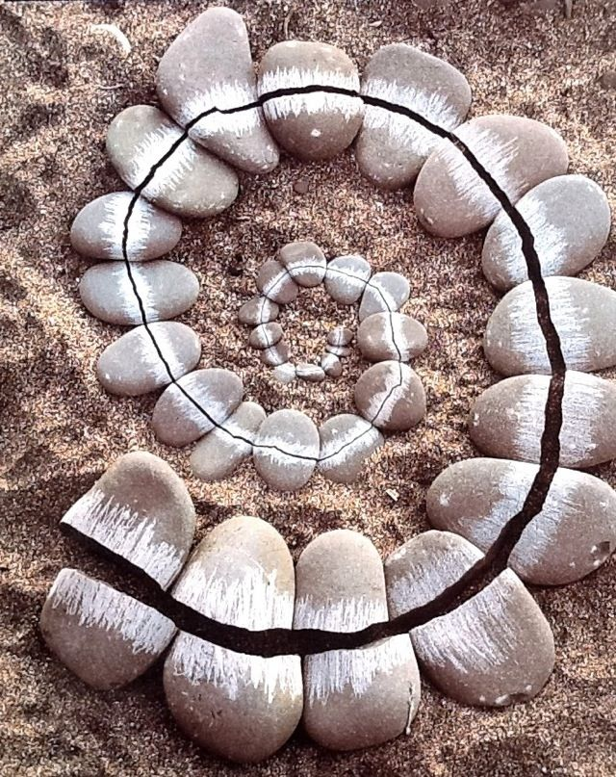
Andy Goldsworthy often uses circles, spirals and curved lines in his work.
How would you describe how this land art has been created?
Are all the stones the same size and shape?

Slide 5
What did you notice?
The stones are smaller in the centre of the spiral. This gives the impression of the spiral disappearing into the sand.
Most of the stones are oval shaped but a few are almost triangular shaped.
Can you spot these stones?
Do you think the stones in the centre have been spilt in two?

Slide 6
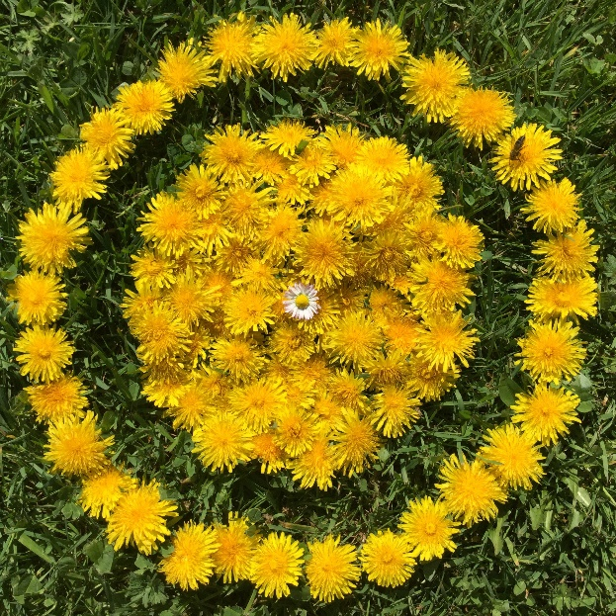
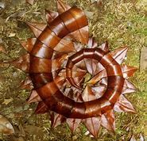
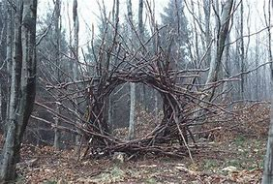
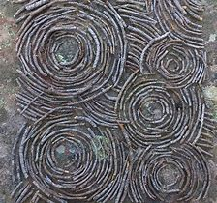
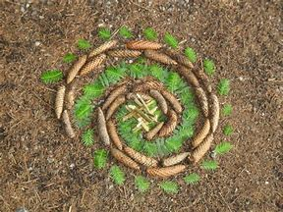
Now go outside and see if you can create your own spiral or circle
using natural materials.
Where does your spiral or circle start and stop?
Does it fit around other land features such as trees or plants?
Can you create a pattern in your spiral or circle ?
Can you make your spiral or circle 3-dimentional ?
Don’t forget to take a photograph of your spiral or circle
to keep as a record of your work.

Slide 7
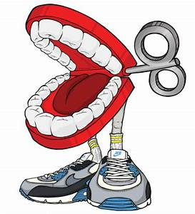
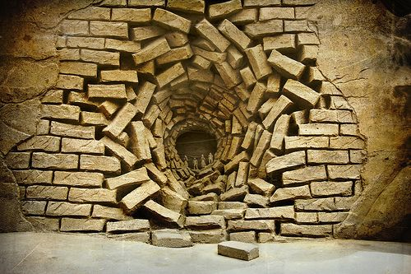
Chatter Challenge
What do think has happened to this sculpture?
Look closely at the center.
What can you see?
Notes:
Image 1: Leaf Horn.
Image 2: Rowan leaves laid around a hole.

