Slide 1
Home Learning Pack
Key Stage 1
Key Stage 1 Science – Living things and their offspring
- Recognise that offspring are very much, but not exactly, like their parents.
- Animals, including humans , have offspring which grow into adults

Slide 2
Do animal babies always look like their parents?

Slide 3
Read ‘Monkey Puzzle’ by Julia Donaldson
https://youtu.be/-OHVpSelKK4
Why do you think the butterfly kept
getting it wrong?

Slide 4
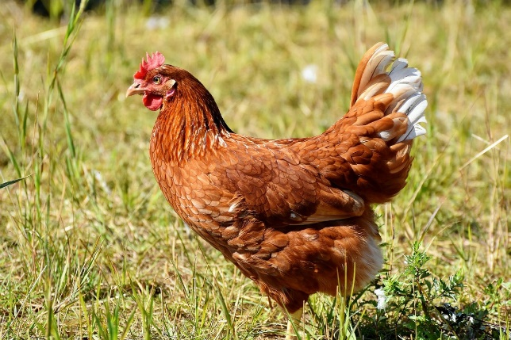
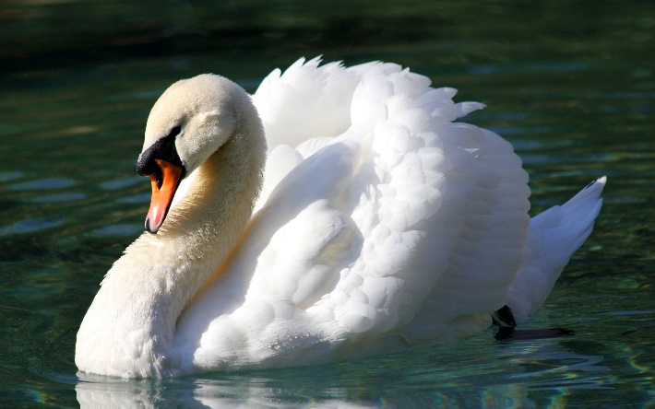
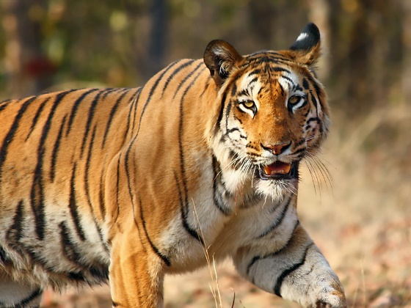
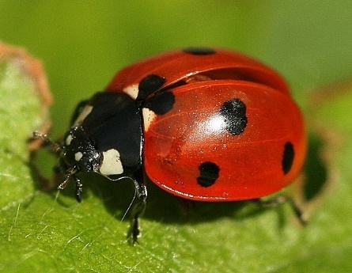
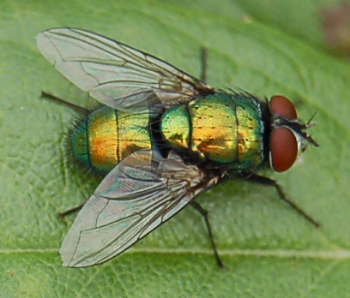
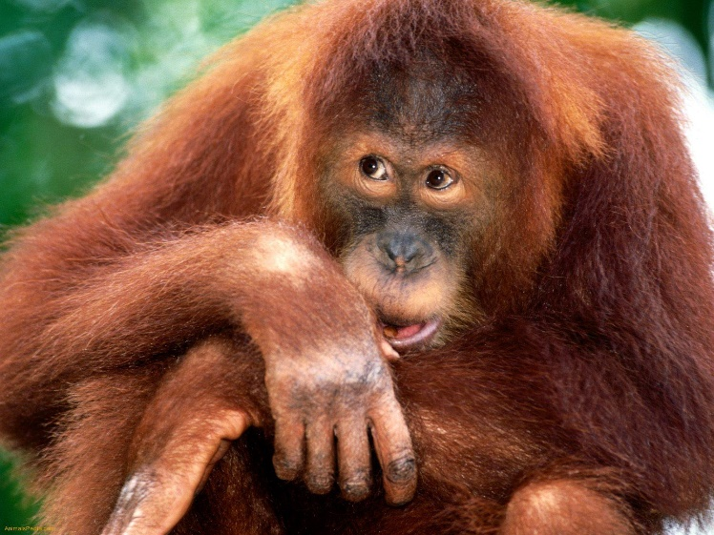
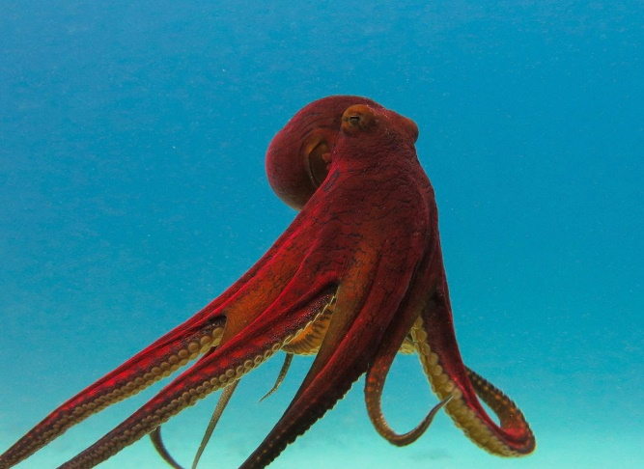
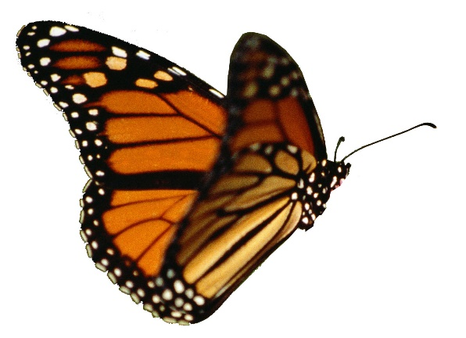
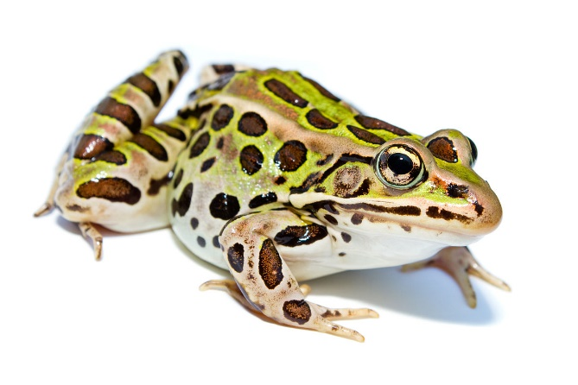
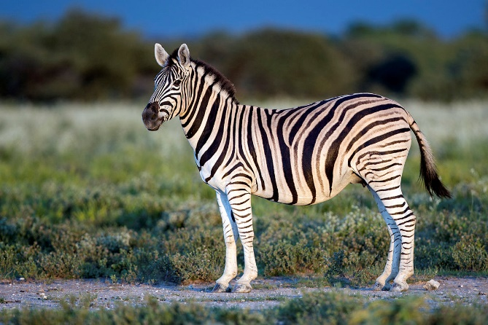
Not all animal babies look like their parents.
Some look similar and others look complete different.
Can you guess which of these animals have babies
that look similar to their parents and which have babies that look
completely different?

Slide 5
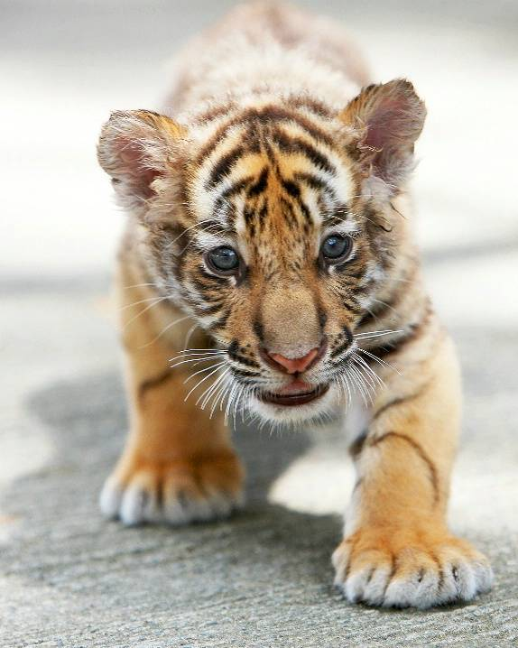
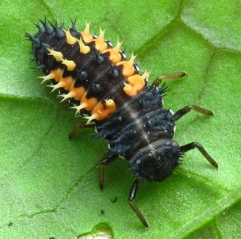
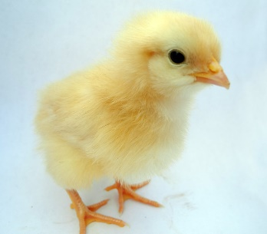
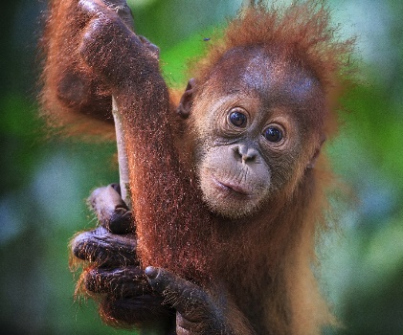
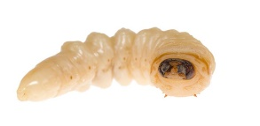
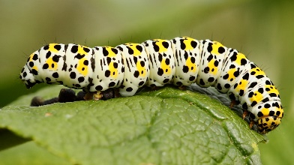
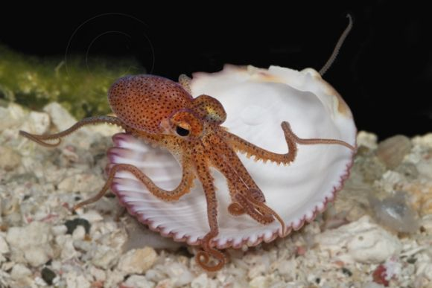
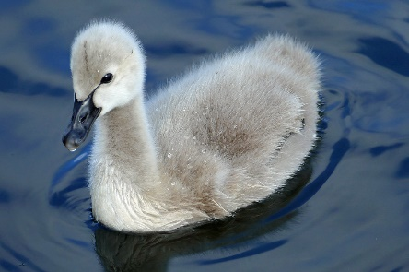
Similar
Different
cub
larvae
foal
chick
tadpole
maggot
caterpillar
Baby orangutan
cygnet
Octopus hatchling

Slide 6
So why do some babies look the same and some look different from their parents?
It is all to do with the type or species of the animal, where it lives (habitat) and what it eats.
Mammals give birth to live young and so need their mother’s milk when they are born.
Mammal babies rely on their parents to keep them safe from predators and teach them how to survive.
Reptile babies are born looking like a smaller version of their parents.
Most reptile parents don’t hang around to look after their young.
Amphibians look very different from their parents when they first hatch. They lay their eggs in water because they have a better chance of surviving there as their eggs are soft and don’t have a hard shell that protects them from the sun. The babies then have to change and adapt so that they can survive on land and in water.
Some fish take care of their young when they are born and some don’t.
Birds look after their young until they are ready to leave the nest.
They constantly feed them to help them grow big and strong.
Most insects also look very different from their parents. Bees and wasps will bring food to feed their larvae but some insects don’t care for their young. Some spider mums will even let their young eat them to survive.

Slide 7
Investigation Station
What can you find out about animal babies?
Choose an animal and see if you can find out more about them.
Do the babies stay close to their parents.
Do they sometimes wander away on their own
to play or look for food?
Do other adult animals, besides the mother or father,
help take care of the baby animals?
(Families of gorillas and elephants usually help with baby animals.)
Do the mother or father feed their babies and take care of them?
(Most birds and mammals do but reptiles and amphibians usually don’t.)
What do the baby animals eat?
Do they eat the same food as their parents?
Do the parents carry their babies around?
(Monkeys and koalas do.
Even cats and dogs sometimes carry their young!)
Can the babies walk, run, or swim on their own?
What are some ways that
animal babies and human babies are different?
Can you think of some ways that animal
babies are similar to human babies?

Slide 8
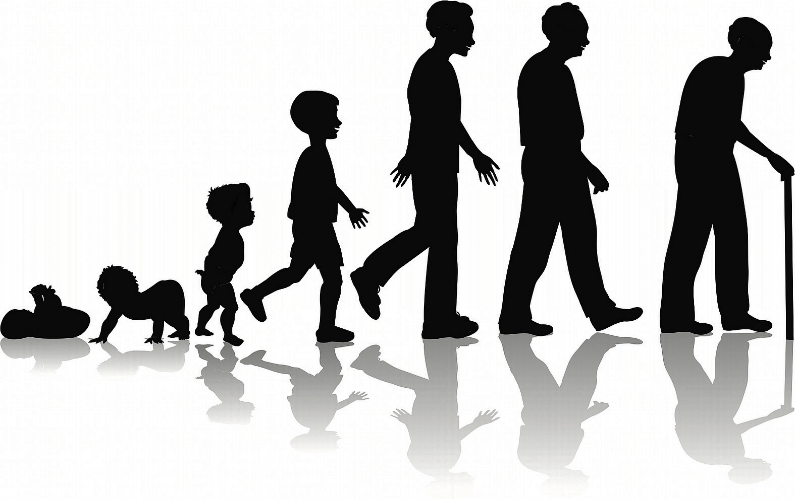
So what about humans?
Human babies can not survive without their parents or adult to look after them.
Humans go through a lot of
changes as they grow older.
Can you say how we change as we
get older ?

Slide 9
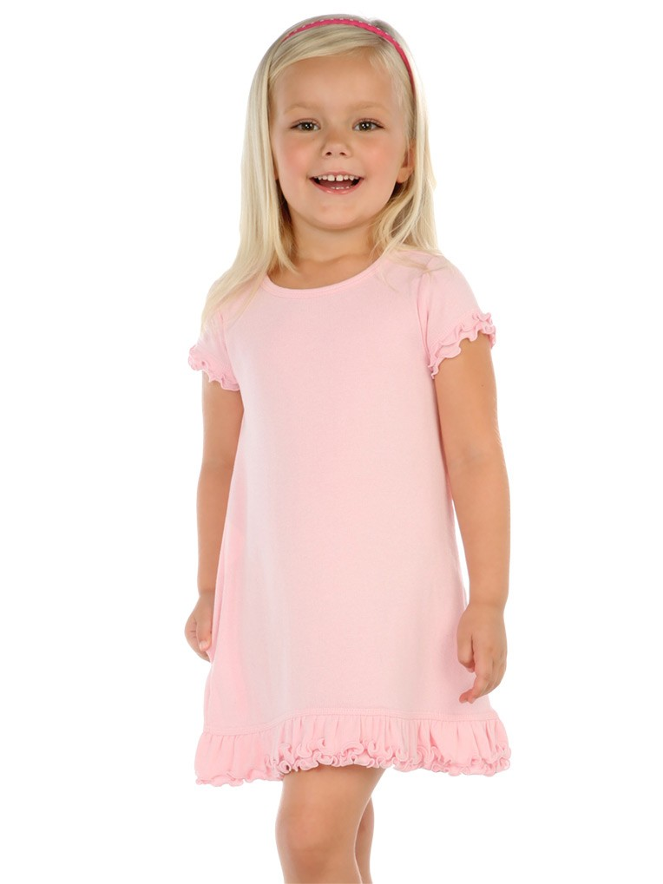
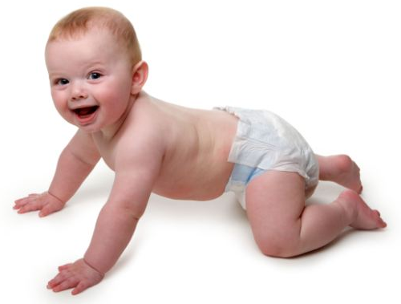
Can you say which of these people is the oldest?
Who is the youngest? How can you tell?

Slide 10
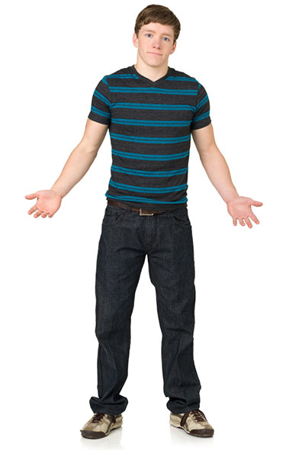
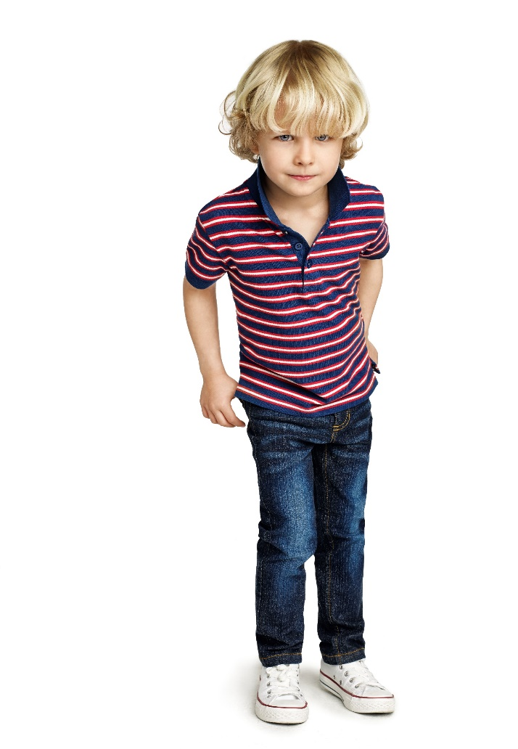
Can you say which of these activities you can
do as you grow?
drive a car
feed yourself
speak
write
crawl
read
sleep
run
Can you think of anymore things you can or can’t do?

Slide 11
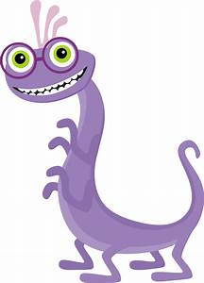
Investigation Station
As your body grows it grows in proportion. That means as your feet get bigger, your legs get longer, your arms get longer and your hands get bigger.
Did you know that your feet are the same size as your forearm?
Plan an investigation to see if this is true.
Use Purple Mash to record your investigation
and results.

