Slide 1
Learning Pack
Key Stage 1
Key Stage 1 Science – Animals, including humans /Keeping Healthy
Lesson 2 – The importance of exercise
Lesson 3 – The importance of eating the right amounts of different types of food.

Slide 2
Why do you think exercise is important for keeping healthy?

Slide 3
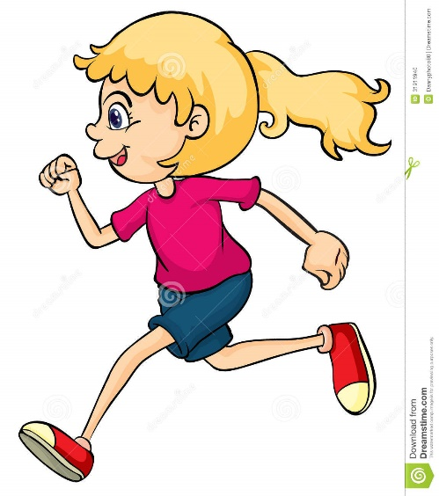
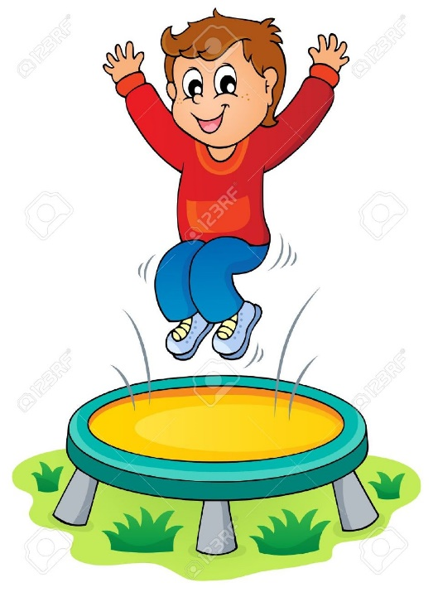
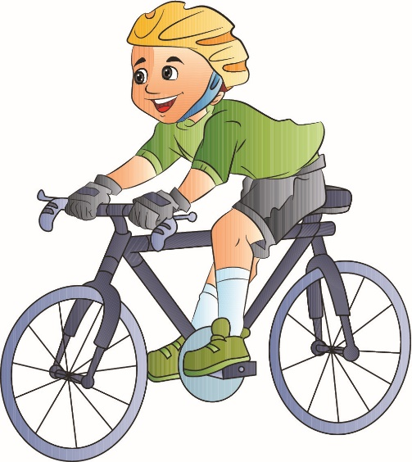
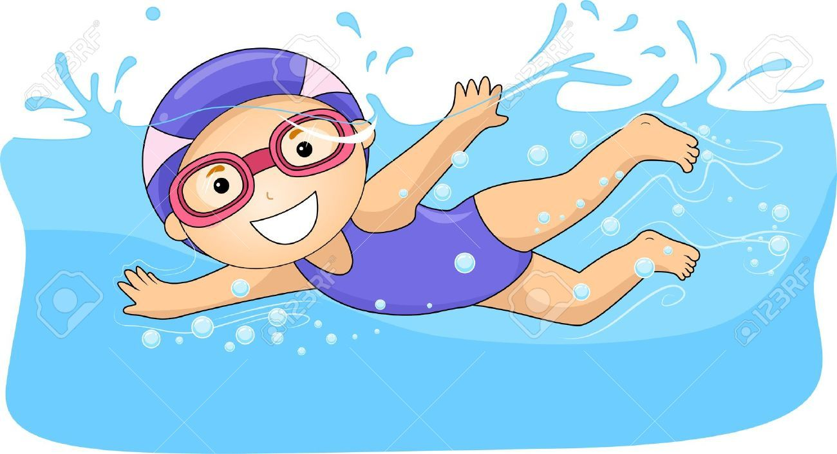
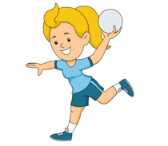
Exercise is anything we do that uses your body
in a physical way, such as walking, swimming,
jumping, throwing, dancing.
Exercise helps to keep your heart and lungs healthy.

Slide 4
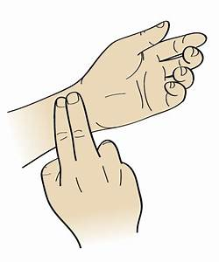
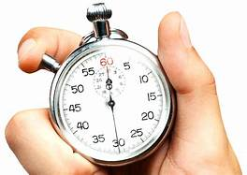
What happens when you exercise?
Try it
out!
Use the chart on the next page to collect
data about exercise.
For each stage measure and record your pulse.
Ask a grown-up to time you counting how many
pulses you can feel in 30 seconds.

Slide 5
Name of exercise or activity. | What part of the body am I using? | How many pulses can I measure in 30 seconds? | What happens to my body?
a) Rest
b) Touching head then toes, head, toes…
c) Rest
d) Jumping on the spot
e) Rest
f) Running
g) Rest

Slide 6
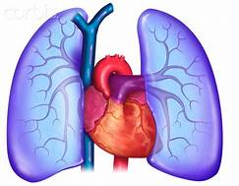
What did you notice ?
Did you notice that your heart started beating harder
and you were breathing quicker when you were moving and exercising?
This is because your heart was working hard to pump more blood
around your body.
The more you exercise, the more your heart and lungs have to work.
Lungs
But what about the rest of your body?
Can you guess how exercise might help to improve
something else in your body?
Heart

Slide 7
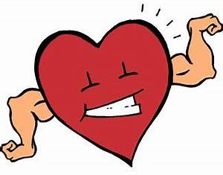
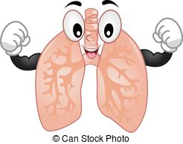
Exercise is good because it makes our muscles strong and flexible and helps our heart to pump blood around our body.
Exercise also makes your lungs stronger so that they are more efficient at taking in oxygen and getting rid of carbon dioxide from your body. Oxygen is needed to help power your muscles.

Slide 8
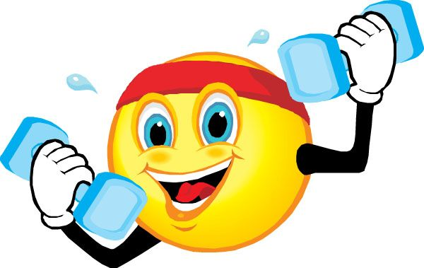
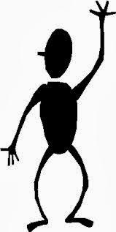
Can you invent an exercise to strengthen
each part of the body?
Can you do this exercise
inside or outside?
Do you do this exercise fast or slowly ?
brain
Do you need any equipment?
arms
stomach
How many times do I need to do this exercise?
legs

Slide 9
Lesson 3: The importance of eating the right amounts of different types of food.
What is your favourite food?
Why do we eat food?

Slide 10
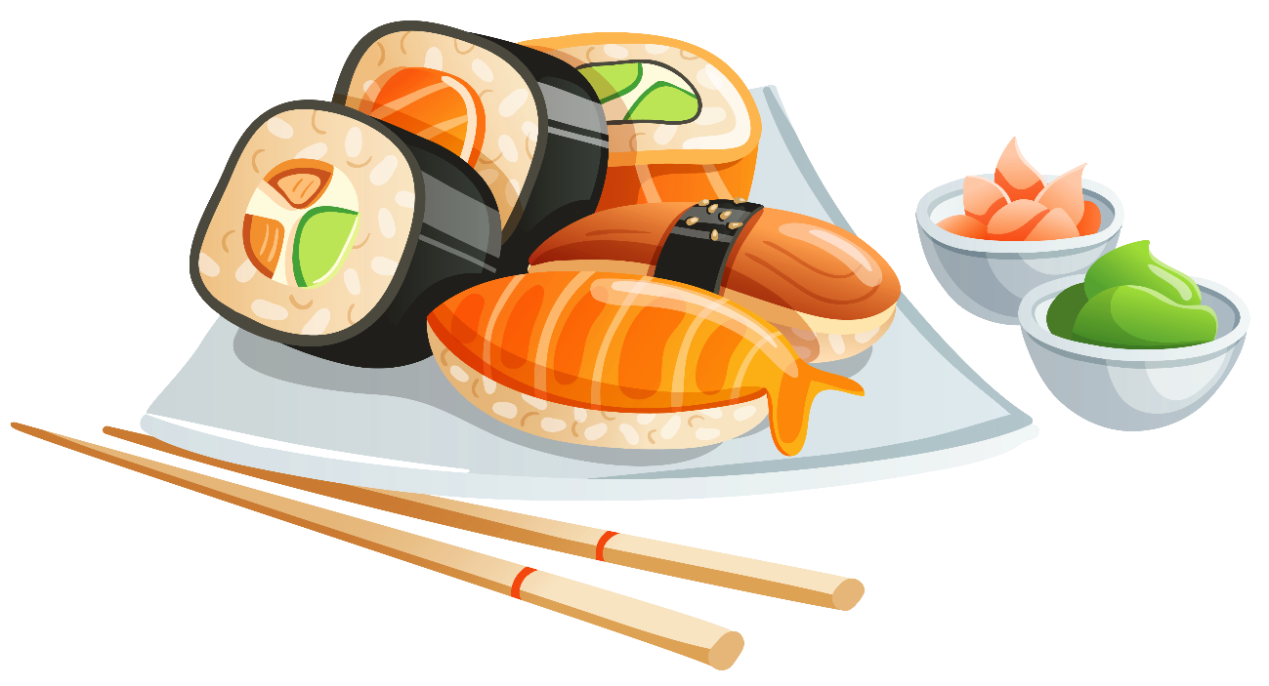
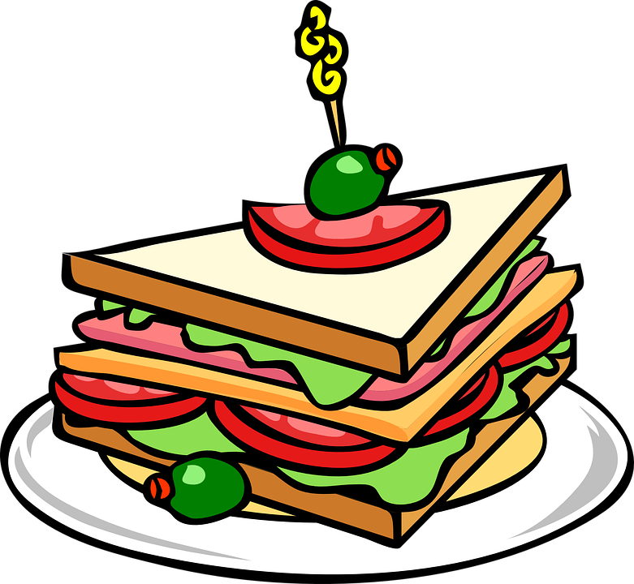
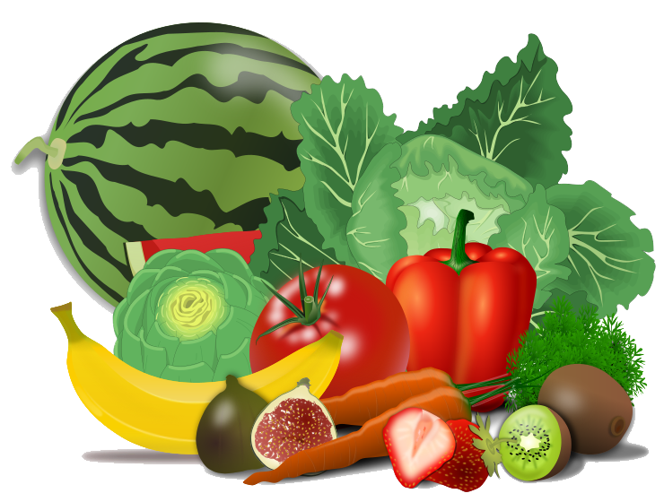
We eat food because it gives us the energy needed
to move and grow.
We also need food to keep our bodies healthy.
Food contains vitamins, minerals and other nutrients
that keep our bodies working properly.

Slide 11
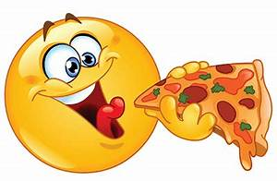
Different types of food are useful to our bodies for different things,
so when we talk about a balanced diet, it means we need to
make sure we eat the right kinds of food to keep us healthy.
If you only ate one type of food you would soon become ill.
You need to eat lots of different foods to get all the
nutrients your body needs.

Slide 12
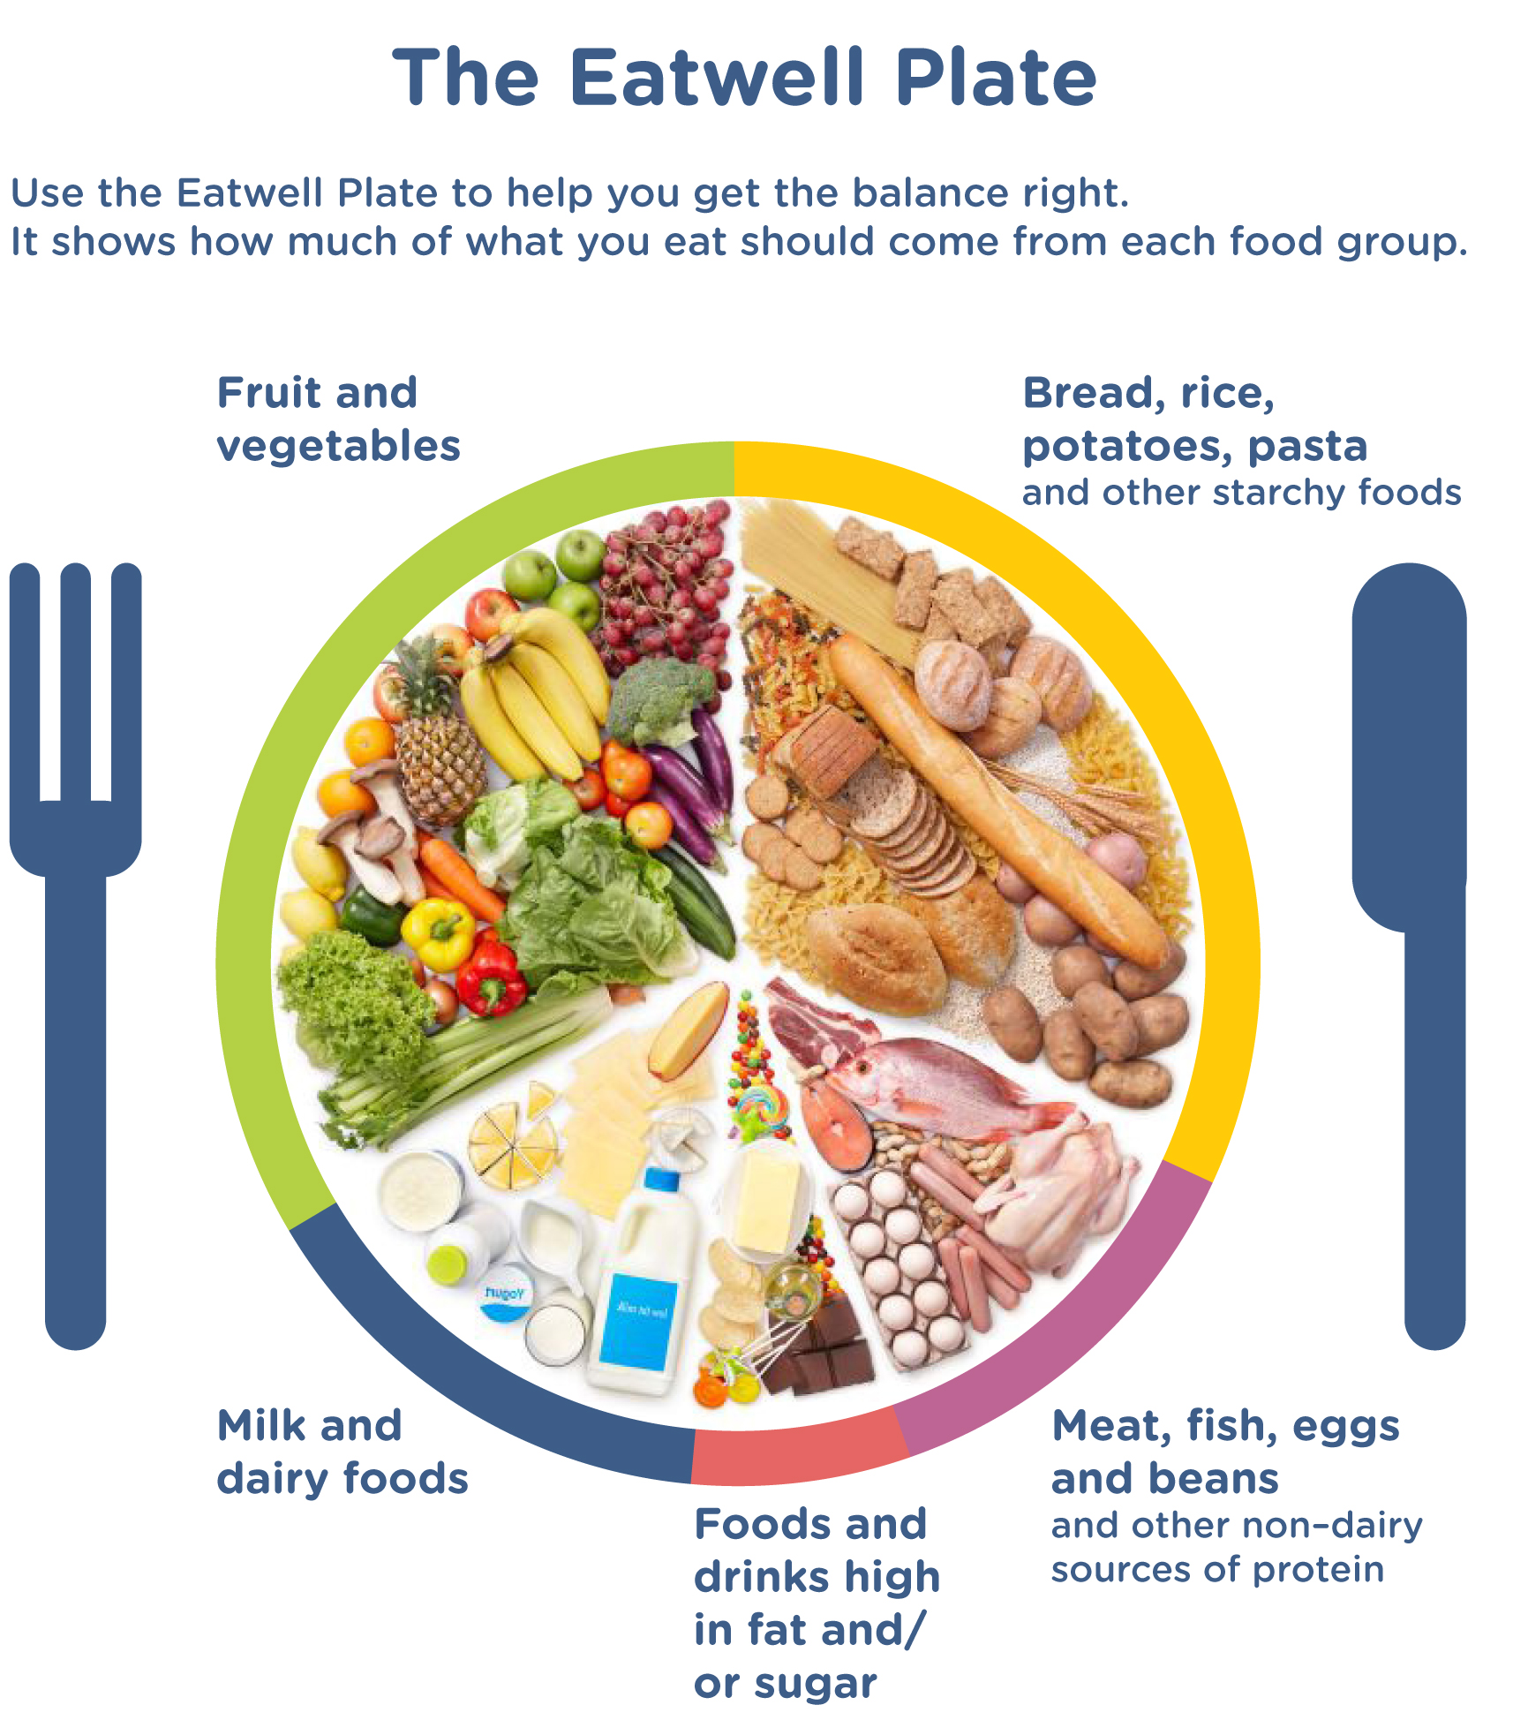
The Eatwell plate.
These foods are also called
carbohydrates.
We can eat lots of these
because they give us lots
of energy and make us feel full.
We need to eat
fruit and vegetables
because they contain lots of
vitamins and minerals.
Food that contain protein
help us grow and build
strong muscles.
Dairy foods contain calcium
which is important
for strong teeth and bones.
Eating too much
fat and sugar can
be very bad for you.

Slide 13
Can you draw healthy food on the plan for each mealtime?
lunch
dinner
breakfast
snacks

Slide 14
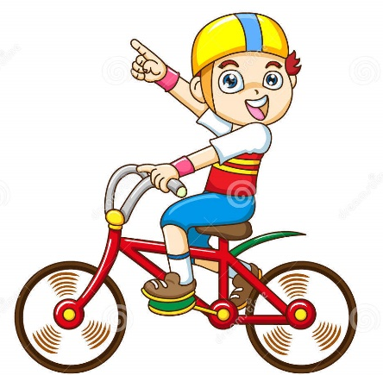
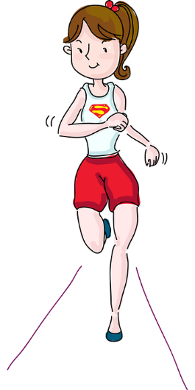
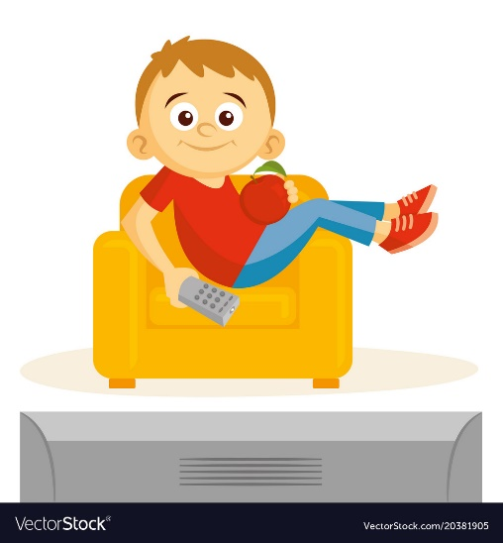
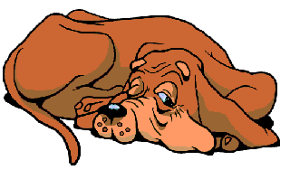
Look at the children below, read what they tell you about the amount of exercise they take and food they eat. Give them a mark out of 10 for how healthy you think they are, 10 being very healthy and 0 being very unhealthy.
Mark out of 10!
Hi I’m Ben. I am 7 years old. I love to ride my bike, in fact I ride it everyday. I also like to play football with my friends. I don’t like fruit and vegetables but I do like crisps and chocolate cake. I drink fizzy cola when I am thirsty.
Can you give a
reason
for your mark?
Hi I’m Jen. I am 10 years old. I love to run and try to run further and faster each time I train. I also go to gymnastics on a Tuesday. At the weekend though I take things easy and love to read my books. I eat fruit and vegetables and occasionally I treat myself to handful of chocolate buttons. I drink lots of water throughout the day.
What would you
say to the
unhealthiest
child to persuade
them to do
something healthy ?
Hi I’m Ken. I am 8 years old. I love to watch the TV and play on my computer games. I only go outside when my mam makes me take Rover for a walk. I love to eat pasta and pizzas. I like to drink banana milkshake.

Slide 15
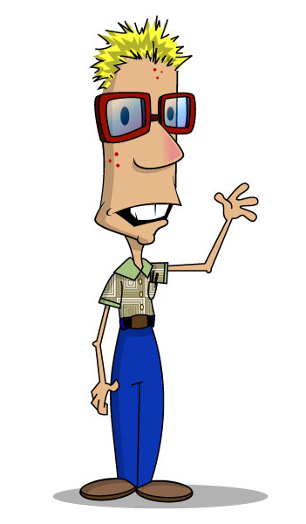
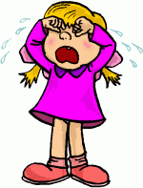
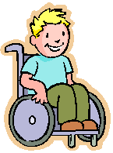
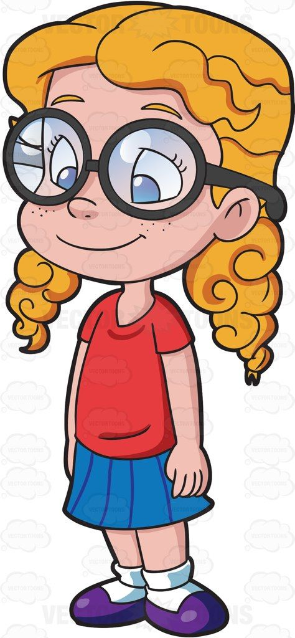
Superhero Training Camp
Here are your new recruits for Superhero Training Camp!
Can you plan a range of exercises that will improve their fitness and make them feel healthier and happier.
Can plan a healthy diet full of super foods to help improve their brain power and well being.

