Slide 1


Slide 2
Lower Key Stage 2
Information Session
Wednesday 7th September
2022

Slide 3
Staff
Class 7 – Mrs Cowan
Class 8 – Miss Boden
Class 9 – Mr Boxshall
PE – Mr Dowson
Mrs Trundley, Mrs McCabe
Miss Swaddle, Mrs Whittingham
Mrs Nicholson Phase leader

Slide 4
Daily routines
Doors open 8:45am
Water
Snacks: Children to bring in their own healthy snack to be eaten at break. Those having milk will have this during library time.
Lunch: 12:15-1:15
Dismissal at Home time

Slide 5
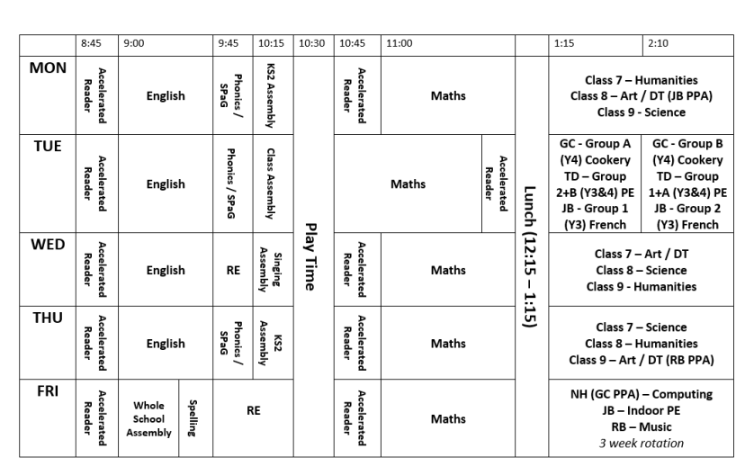
Timetable

Slide 6
Blue Book
*Purpose
*Information included
*How it’s used in school

Slide 7
Uniform
Jewellery/make up/hair
Sports Kit:
PE Tuesday and Friday
Label Uniform
Forest School; Y4 Autumn 2, Y3 Spring 1,

Slide 8
Homework
FRIDAY TO FRIDAY
Maths :
TTRS weekly (approximately 10 minutes)
Paper homework (approximately 15 minutes)
Thursday to Thursday
English:
Weekly Spellings
Paper homework/ digital

Slide 9
Challenge Award
Our World
Staying Healthy
Great Outdoors
Creativity
School Awards

Slide 10
Northburn Values
Be ambitious
Be inquisitive
Be respectful
Be resilient

Slide 11
FROG
AUTUMN
SPRING
SUMMER
Information on the website how to access your account

Slide 12
Further Parent Workshops
Phonics workshop
Maths workshop
E-Safety workshop
New school website

